Slide 1

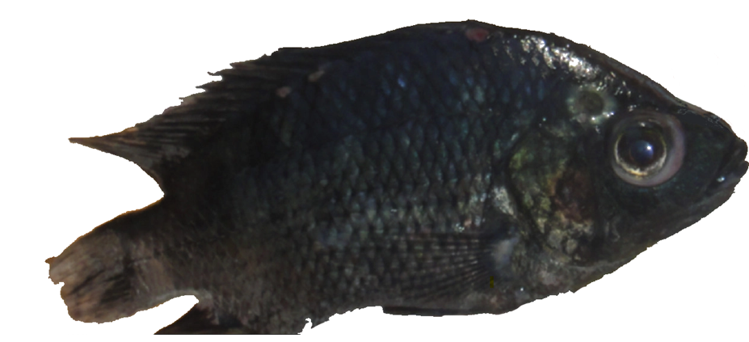
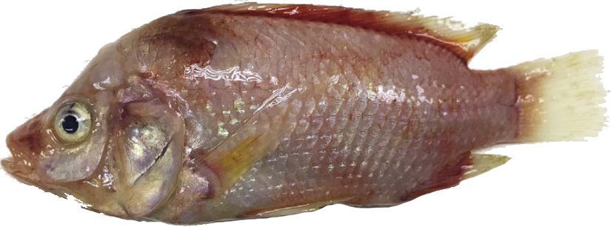
Systemic and mucosal immune response of Nile tilapia broodstock to monovalent and bivalent vaccines against bacteria Streptococcus agalactiae and Aeromonas veronii.
MASTER RESEARCH PROJECT PROPOSAL
Quentin ANDRES
MSc. Aquaculture and Aquatic Resources Management @Asian Institute of Technology, Pathum Thani, Thailand
August 2021

Slide 2
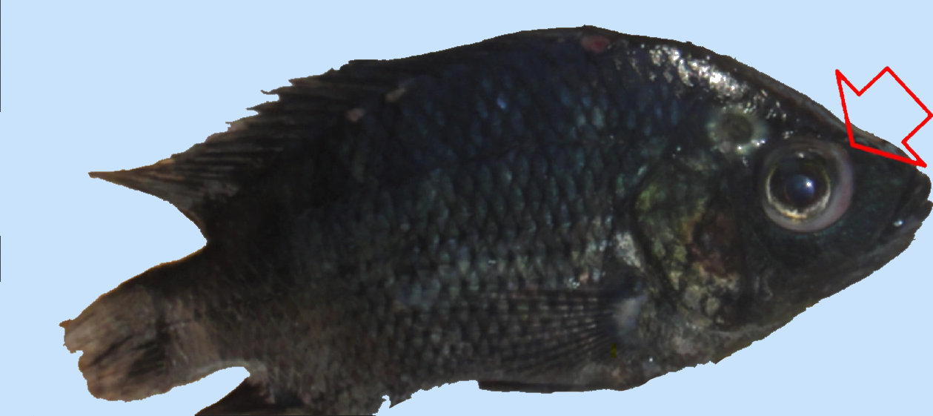
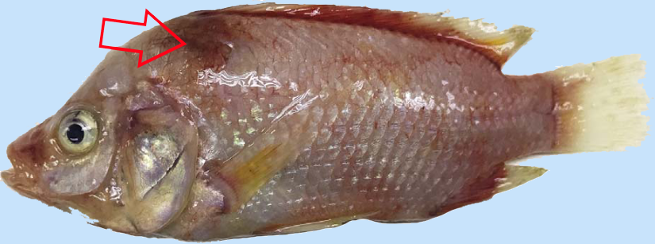
Nile tilapia Aeromonas veronii / Streptococcus agalactiae infection
(Left) Red hybrid tilapia juvenile that positive to TiLV and Aeromonas veronii showing
skin redness and hemorrhages around the operculum area, body and base of dorsal,
caudal and anal fins.
(Right) Black Nile tilapia displaying exophthalmia (pop-eye) and corneal opacity after infection with Streptococcus agalactiae.

Slide 3
Executive summary
There is currently no vaccine against the 2 pathogens available to farmers in Thailand.
Several disease outbreaks have been reported in the past, mostly during hot seasons and after the diminution of DO in the water.
This research project aims to characterize the immune response of the Nile tilapia to inactivated vaccines for the 2 pathogens:
The production of at least 3 vaccines (2 monovalent, 1 bivalent)
Assessment of vaccine efficiency in juveniles and in chiltralada 4 broodstock
A vaccine efficacy-indicating study for Tilapia will be held and results published.

Slide 4
What led to this project proposal ?
My high interest and motivation to work in biotechnology
My background in molecular biology and genetics combined with my aquaculture knowledge
My recent ramp-up on bioinformatics and mRNA vaccine design for TiLV disease
My interest in low-cost experimental designs to achieve mRNA synthesis
My assumption that CEV and TiLV infection mechanism are very close on a molecular standpoint
The fact that sustainable intensification of aquaculture will only be possible if vaccination protects the fish from recurrent disease outbreaks.

Slide 5
Building the research project
Initiation
Review existing literature on vaccination using Inactivated vaccines and antibody response and immunology of Cichlids.
Planning
Breakdown of project work in phases, define milestones and deliverables
Executing
Write master thesis (publishable article draft and send for review)
Prepare materials list (fish, vaccine sample, raw material for vaccine production)
Protocols writing for heat killed/formalin vaccine development
Execution of the challenge tests and deliver an efficacy-indicating study
Protocols writing for challenge tests and ELISA/PCRs.
Closing
Publish manuscript in aquaculture journals.
Define methodology to be used during each project phase
Validate the use of lab facilities if external to AIT (SSRU, Mahidol Centex Shrimp)
Conceptualization : Ideas; formulation or evolution of overarching research goals and aims.
Project administration : management and coordination responsibility for the research activity planning and execution.
Funding acquisition : Acquisition of the financial support for the project leading to this publication.
Bi-mensual progress report

Slide 6
Research project high level schedule
AUGUST
SEPT
OCTOBER
NOV
DECEMBER
JAN
FEBRUARY
MARCH
APRIL
MAY
Bibliography
Production of Inactivated vaccine
Conceptualization &
Methodology
Write protocols
Resources
Challenge test and result analysis
Data Curation
Writing - Original Draft
Final draft- Preprint
SEPT w1
SEPT w2
SEPT w3
SEPT w4
OCT w1,2
OCT w3,4
NOV
DECEMBER
JAN w1-2
Fish culture (Broodstock in the main pond; Volume = 10.000 Liters)
Production of Inactivated vaccine
Production of juveniles by broodstock strain Chiltralada IV (Size 60 to 90 grams)
Acclimatation of the juveniles (12 days)
Inactivated vaccine inoculation (1,2,3 doses)
&
Immune response (antibody response) of the fish via ELISA, PCR..
Transfer of juveniles into 4 ponds for the experimentation

Slide 7
Project organization and funding
Project organization
Since Chiang Mai university has recently worked on CEV, I plan to contact them to see in which way they could support me in this project (May-June)
See if I can find scientific support from European research units working on a similar project
Lab facilities access needs to be assessed (June-July)
I would need to find a referent professor/tutor (May-June)
Project fundings
AIT Initiative research found

Slide 8
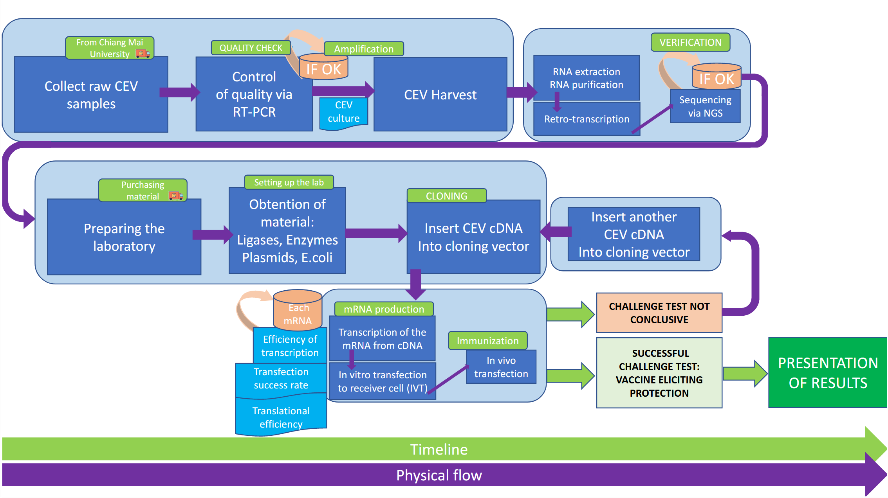
Proposed workflow

Slide 9
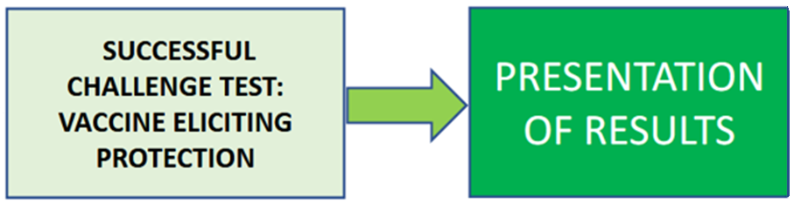
Expected outcomes of the proof of concept
Analysis of challenge tests results has proven the efficacy of the mRNA vaccine against CEV

Slide 10
Relevant bibliography
On CEV disease
Shohreh Hesami, Pedro Viadanna et al. https://edis.ifas.ufl.edu/pdf/FA/FA18900.pdf
Amita, K., M. Oe, H. Matoyama, N. Yamagushi, and H. Fukuda. 2002. "A survey of Koi herpes virus and carp edema virus in colorcarp cultured in Niigata Prefecture, Japan." Fish. Pathol. 37:197–8.
Aaenen, O., K. Way, D. Stone, and M. Engelsma. 2013. "Koi Sleepy Disease found for the first time in koi carps in the Netherlands." [in Dutch]. Tijdschr. Diergeneeskd. 5:27–29.
Lewisch, E., B. Gorgoglione, K. Way, and M. El-Matbouli. 2015. "Carp edema virus/koi sleepy disease: An emerging disease in central-east Europe." Transbound Emerg Dis. 62:6–12.
On mRNA vaccine design against TiLV
Pardi, N., Hogan, M., Porter, F. et al. mRNA vaccines — a new era in vaccinology. Nat Rev Drug Discov 17, 261–279 (2018). https://doi.org/10.1038/nrd.2017.243
Gómez-Aguado, I.; Rodríguez-Castejón, J.; Vicente-Pascual, M.; Rodríguez-Gascón, A.; Solinís, M.Á.; del Pozo-Rodríguez, A. Nanomedicines to Deliver mRNA: State of the Art and Future Perspectives. Nanomaterials 2020, 10, 364. https://doi.org/10.3390/nano10020364
On usage of low-cost design experiments in biotechnology
https://pipettejockey.com/2019/11/22/teda-cloning-cheap-easy-gibson-alternative/
https://pipettejockey.com/2020/02/05/t4-dna-ligase-plasmid-brought-to-you-by-chemically-incompetent/
https://barricklab.org/twiki/bin/view/Lab/ProtocolList

Slide 11
Thank you !

